Slide 1

Anti-patterns
Cujba Daniel
Coroiu Adela
Dumitrana Mihnea

Slide 2
How we have split the workload
Cujba Daniel and Dumitrana Mihnea - dug through online resources, (such as GitHub), to gather open-source code examples.
Coroiu Adela – prepared the theoretical part of the project.

Slide 3
What are design anti-patterns?
they are patterns that do not present benefits and can harm the benefits achieved from other design patterns [1]
can be understood as bad habits or repetitive behaviors that initially seem inoffensive or beneficial. However, with the programming project progress, antipatterns become a problem for the team [1]

Slide 4
Magic Numbers anti-pattern
In general, magic numbers refer to hard-coded numeric values that are directly used within a program’s logic.
This practice is typically discouraged for several reasons, some common examples including [1]:
  constant values being used multiple times in the code without being given a descriptive name
  numeric values that represent identifiers for protocols or file formats that aren't clearly defined
  unique values appearing only in one part of the code, with no broader meaning or documentation

Slide 5
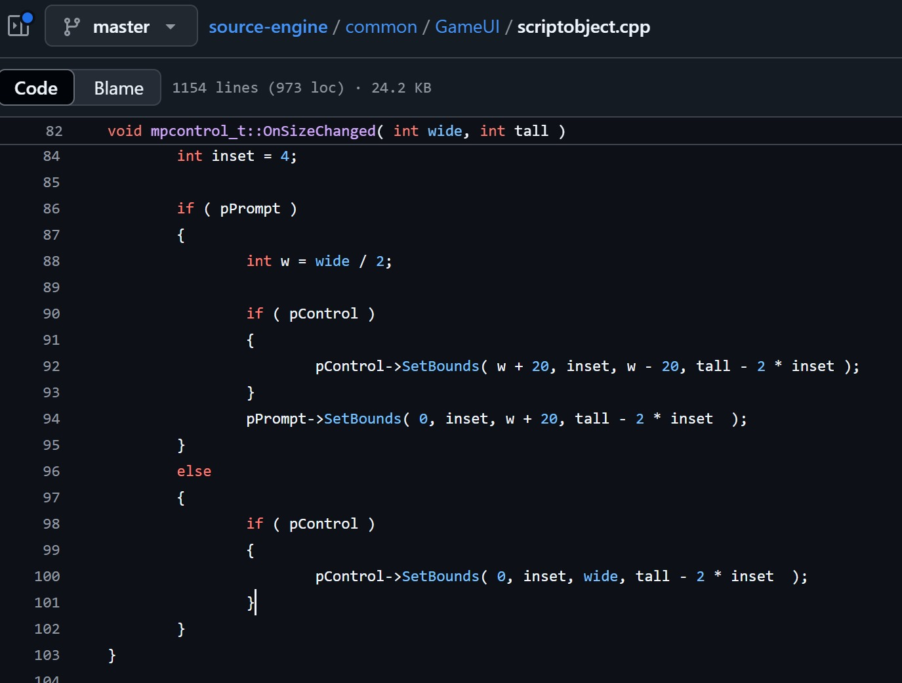


Great example of magic numbers, random constants added or subtracted from a width value
20 what, 20 who, we’ll never know unless we ask the guy who wrote it
[2] Source-engine

Slide 6
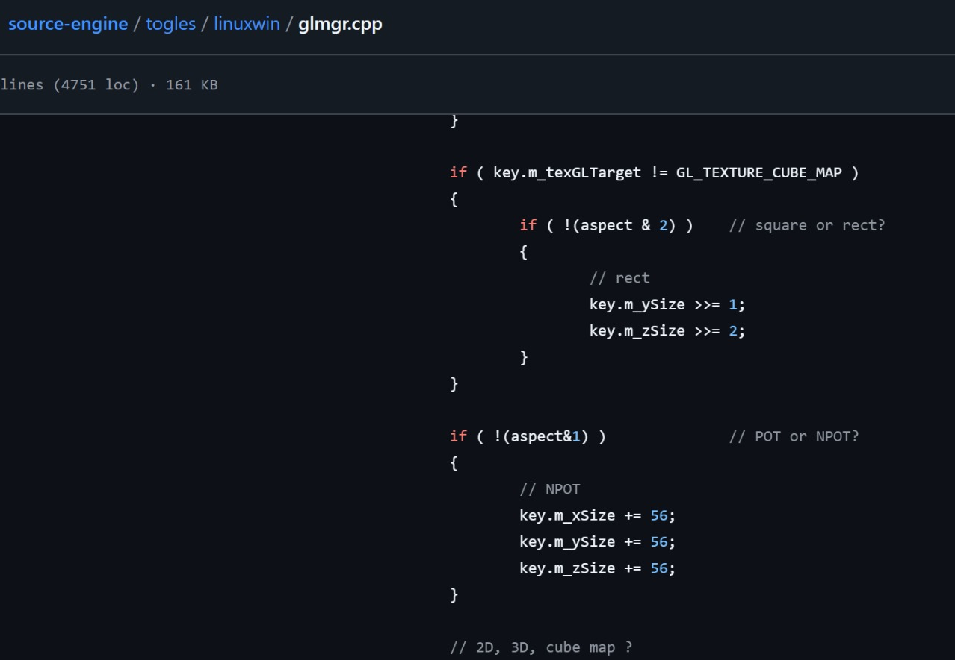

Another example from the source-engine …those Valve engineers must really like their magic numbers
[2] Source-engine

Slide 7
God Object anti-pattern
A God Object is a class or component that tries to control too much within an application.
It usually has the following characteristics:
  possesses extensive knowledge about various parts of the system
  takes on multiple, unrelated responsibilities
  serves as a central point for many operations, often violating separation of concerns

Slide 8

God Object anti-pattern in a nutshell [8]

Slide 9
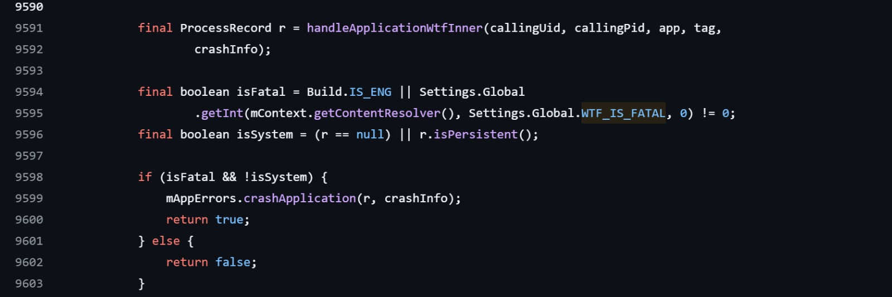
[4] Source code
A relevant example for the God Object anti-pattern would be ActivityManagerService.java, which is a core Android service file that contains almost 20,000 lines of java code. Super!

Slide 10
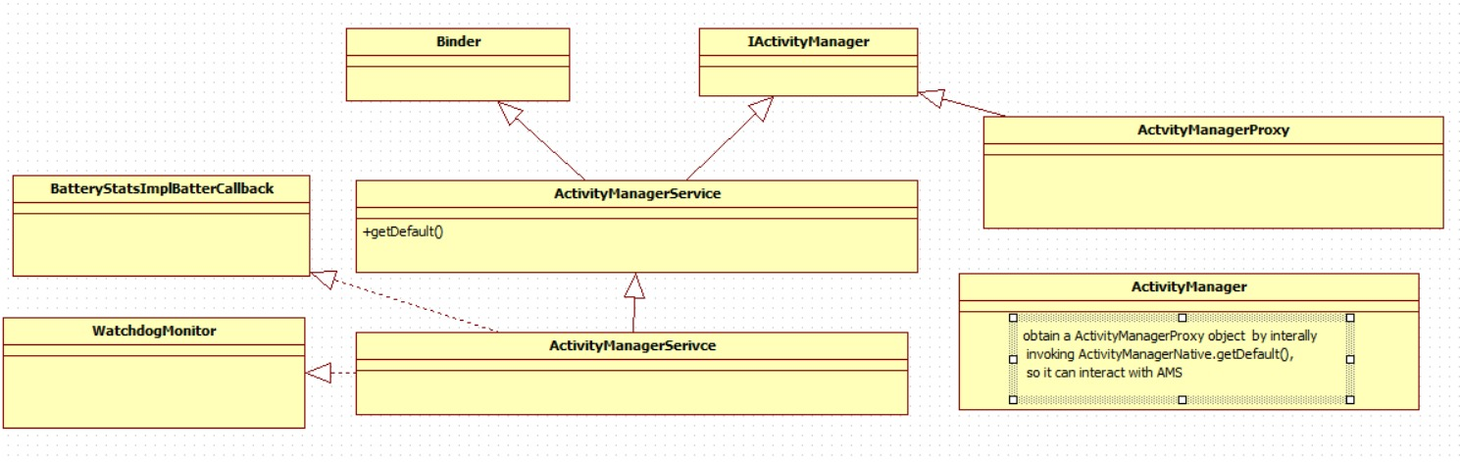
ActivityManagerService class diagram [7]

Slide 11
Another good example for the God Object anti-pattern is the DispatcherServlet [5] in Spring MVC , as it is a central class that is responsible for a wide range of unrelated concerns such as: routing HTTP requests to handlers, handling exceptions, resolving views, managing multipart uploads, translating requests to view names and many more. As described, it knows too much about the system and it makes the class harder to test, maintain or extend independently.

Slide 12
Over-Engineering Architecture anti-pattern
Over-engineering is a software development anti-pattern where unnecessarily complex solutions are built for problems that could be solved more simply [6].
This anti-pattern can lead to the following issues [6]:
  an increased learning curve, developers being compelled to invest more time and mental effort to understand unfamiliar tools and concepts, which can slow down development
  code fragmentation, logically related code may become scattered across multiple files or modules
  reduced readability, extra framework-specific code can make the system harder to follow, increasing fragility and making maintenance more difficult over time

Slide 13

Over-engineering in a nutshell [9]

Slide 14
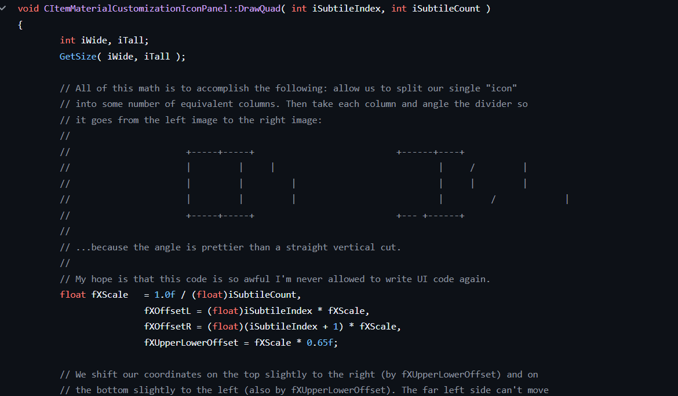


Team Fortress 2 (open source) code [10] – A gold mine for over-engineering
Normal item color splash
What this code is trying
to accomplish in a very
complicated matter that
supports n colors

Slide 15
References
[1] Baeldung, “Antipatterns: Magic Numbers”, https://www.baeldung.com/cs/antipatterns-magic-numbers
[2] Copyright Valve Corporation, Source-engine source code, 2017, https://github.com/nillerusr/source-engine/tree/master
[3] Medium, The “God Object” Anti-Pattern in Software Architecture, 2024, https://dilankam.medium.com/the-god-object-anti-pattern-in-software-architecture-b2b7782d6997
[4] Android source code, https://github.com/aosp-mirror/platform_frameworks_base/blob/master/services/core/java/com/android/server/am/ActivityManagerService.java
[5] Springboot source code, https://github.com/spring-projects/spring-framework/blob/main/spring-webmvc/src/main/java/org/springframework/web/servlet/DispatcherServlet.java

Slide 16
References
[6] Medium, Combatting the Over-Engineering Anti-Pattern in Swift Development, 2023, https://medium.com/geekculture/combatting-the-over-engineering-anti-pattern-in-swift-development-85b8e7bd682f
[7] deep understand of Android ActivityManagerService, 2019, https://wongzhenyu.cn/2019/10/03/deep-understanding-of-Android-ActivityManagerService/
[8] https://www.fredduncan.com/2021/05/02/improving-mechanical-issues-cueing-less/
[9] https://uselessdevblog.wordpress.com
[10] https://github.com/ValveSoftware/source-sdk-2013

